Slide 1
Statistical Learning Methods

Slide 2
Introduction
Agents can handle uncertainty by using the methods of probability and decision theory
But first they must learn their probabilistic theories of the world from experience...

Slide 3
Key Concepts
Data : evidence, i.e., instantiation of one or more random variables describing the domain
Hypotheses : probabilistic theories of how the domain works

Slide 4
Outline
Bayesian learning
Maximum a posteriori and maximum likelihood learning
Instance-based learning
Neural networks

Slide 5
Bayesian Learning
Let D be all data, with observed value d, then probability of a hypothesis h_{i}, using Bayes rule :
P(h_{i}|d) = aP(d|h_{i})P(h_{i})
For prediction about quantity X :
P(X|d)= ∑ P(X|d,h_{i})P(h_{i}|d)= ∑ P(X|h_{i})P(h_{i}|d)

Slide 6
Bayesian Learning
For prediction about quantity X :
P(X|d)= ∑ P(X|d,h_{i})P(h_{i}|d)= ∑ P(X|h_{i})P(h_{i}|d)
No single best-guess hypothesis

Slide 7
Bayesian Learning
Simply calculates probability of each hypothesis, given data, and makes predictions based on this
I.e., predictions based on all hypothesis, weighted by their probabilities, rather than using only ‘single best’ hypothesis

Slide 8
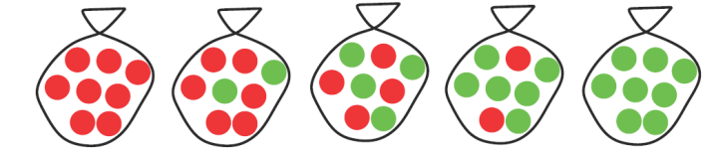

Candy
Suppose five kinds of bags of candies
    10% are h1 : 100% cherry candies
    20% are h2 : 75% cherry candies + 25% lime candies
    40% are h3 : 50% cherry candies + 50% lime candies
    20% are h4 : 25% cherry candies + 75% lime candies
    10% are h5 : 100% lime candies
We observe candies drawn from some bag

Slide 9
Mo’ Candy
We observe candies drawn from some bag
  Assume observations are i.i.d.,
  e.g. because many candies in the bag
  Assume we don’t like the green lime candy
Important questions
  What kind of bag is it? h1, h2,...,h5?
  What flavor will the next candy be?

Slide 10
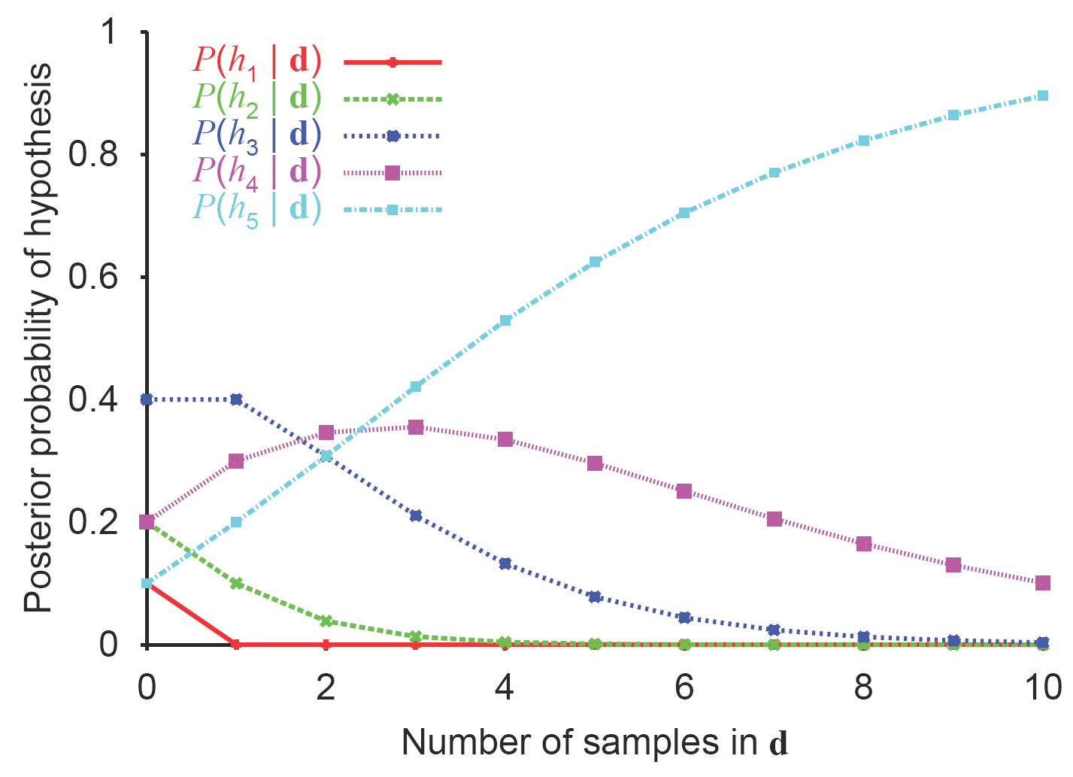
Posterior Probability of Hypotheses

Slide 11

Posterior Probability of Hypotheses
True hypothesis will eventually dominate the Bayesian prediction [prior is of no influence in the long run]
More importantly [maybe not for us?] : Bayesian prediction is optimal

Slide 12
The Price for Being Optimal
For real learning problems the hypothesis space is large, possibly infinite
Summation / integration over hypothesis cannot be carried out
Resort to approximate or simplified methods

Slide 13
Maximum A Posteriori
Common approximation method : make predictions on the single most probable hypothesis
I.e. take the h_{i} that maximizes P(h_{i}|d)
Such a MAP hypothesis is approximately Bayesian, i.e., P(X|d) ≈ P(X|h_{i}) [the more evidence the better the approximation]

Slide 14
Hypothesis Prior
Both in Bayesian learning and in MAP learning, hypothesis prior plays an important role
If hypothesis space is too expressive overfitting can occur [see also Chapter 18]
Prior is used to penalize complexity [instead of explicitly limiting the space] : the more complex the hypothesis the lower the prior probability
If enough evidence available, eventually complex hypothesis chosen [if necessary]

Slide 15
Maximum Likelihood Approximation
For enough data, prior becomes irrelevant
Maximum likelihood [ML] learning : choose h that maximizes P(d|h_{i})
I.e., simply get the best fit to the data
  Identical to MAP for uniform prior P(h_{i})
Also reasonable if all hypotheses are of the same complexity
ML is the ‘standard’ [non-Bayesian / ‘classical’] statistical learning method

Slide 16
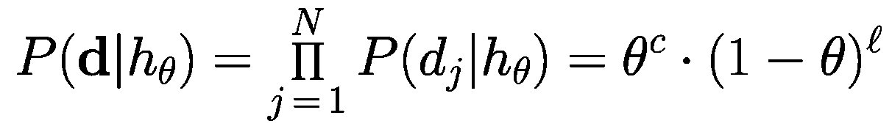
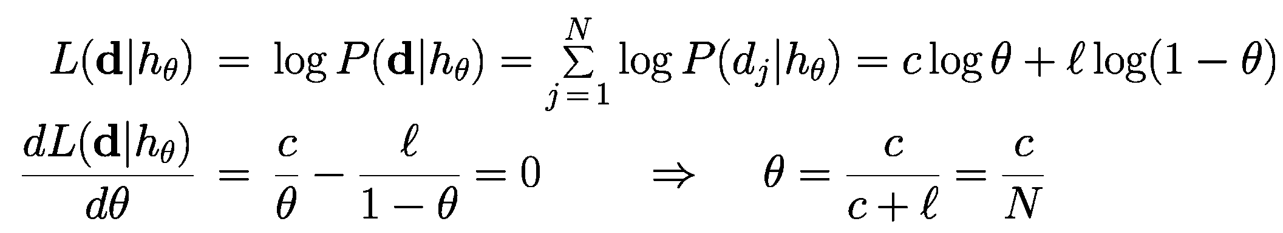
E.g.
Bag from new manufacturer; fraction θ of red cherry candies; any θ is possible
Suppose unwrap N candies, c cherries and l = N - c limes
Likelihood
Maximize for θ using log likelihood

Slide 17



E.g. 2
Gaussian model [often denoted by N(µ,σ)]
  Log likelihood is given by
  If σ is known, find maximum likelihood for µ
  If µ is known, find maximum likelihood for σ

